Slide 1


FINANCE MADE SIMPLE
WealthGenics Educart Pvt. Ltd.
"To create a nation of confident wealth creators…
Leaders who rise, grow and uplift their families."
THANE, MAHARASHTRA • EST. 2020

Slide 2

Corporate Profile
Entity Details
Activity & Industry
Official Name: WealthGenics Educart Private Limited
Primary Focus: Education & Tuition
Specialization: Financial Live Markets
Head Office: Thane, Maharashtra, India
Indian Stock Market
Currency Market (Forex)
Incorporation Date: April 16, 2020
We provide educational courses, live workshops, expert mentoring, and subscription-based modules.
Status: Active

Slide 3
Our Core Philosophy
VISION
To create a nation of confident wealth creators—leaders who rise, grow and uplift their families.
Our vision is a financially empowered India where every home has the courage, skill and wisdom to build wealth.
MISSION
To deliver knowledge, tools and mentorship that turn dreams into tangible results.
Our mission is to transform individuals into skilled traders, strong leaders and true architects of their financial future.

Slide 4


Leadership
Dr. Bajirao Kolekar
Chairman & Managing Director
A visionary in financial education with 19+ years of experience. Dr. Kolekar has collaborated with global traders, mastering wealth-building strategies.
Honored with multiple awards including the Nelson Mandela Nobel Peace Award 2020. Driven by the belief that "Simplicity is the ultimate sophistication."

Slide 5
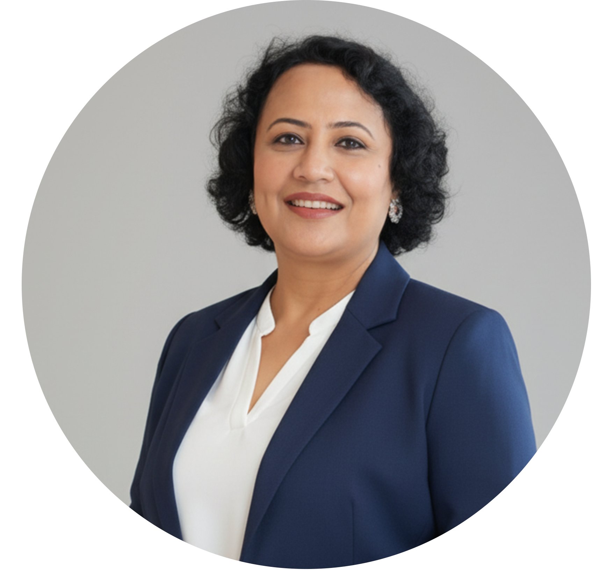
Leadership
Gopa Roy DasGupta
Director & CEO
An award-winning leader with 18+ years of expertise in PR, psychology, and entrepreneurship. Known for a modern approach to leadership anchored in transparency and trust.
Recognized as Woman Change Maker of the Year (2021) and recipient of the Maharashtra Ratna Award 2023. & Rashtriya Ashoka Samman Award from MCA
( Govt. Of INDIA)

Slide 6

How Do You Achieve Financial Freedom in a
World Chasing Money?
While the world chases money…We teach you to build multiple income streams. We guide you to make your money work for you. So even when you pause… your money never stops.
जब दुनिया बस पैसे के पीछे भाग रही है…
हम आपको कई आय स्रोत बनाना सिखाते हैं।
हम आपको सिखाते हैं कि आपका पैसा आपके लिए कैसे काम करे।
ताकि आप रुक भी जाएँ… फिर भी आपका पैसा न रुके।

Slide 7



Why 9 out of 10 fail in wealth creation?
93%
67%
71%
Financially Uneducated. Most people lack the basic knowledge needed to make sound financial decisions.
Experience significant losses without proper guidance in the markets.
Decisions driven by fear and greed rather than strategy. Trading Emotionally.
"While the world chases money… We teach you to build multiple income streams."

Slide 8




WealthGenics is built to solve this.
Structured financial education, mentorship, mindset, workshops
Education
Mentorship
Practice
Success

Slide 9



Why WealthGenics Is A Trustworthy Platform ?
Proven Impact
Expert Mentorship
Certified Excellence
6+ Years of excellence with 78,000+ students trained and a 90% satisfaction rate.
6 Expert Mentors with 10–20 years of live market experience helping you shape your future.
ISO 21001:2018 Certified and recognized by DPIAF and World Human Rights Protection Commission.
A Fully System-Driven EcoSystem

Slide 10
Awards & Certifications – WealthGenics & Leadership
Company-Level
ISO 21001:2018 Certification
Wealthgenics Educart Pvt. Ltd. certified for compliance with Educational Organizations Management Systems, ensuring high-quality education standards
Indian Leadership Award for Visionary Company of the Year
WealthGenics (represented by Gopa Roy Dasgupta) honored by Network Express as a visionary company, symbolizing leadership and excellence
DR. BAJIRAO KOLEKAR (CMD)
Dadasaheb Phalke Icon Award Films (DPIAF) 2020
Awarded as Best Online Financial Education Provider.
Nelson Mandela Nobel Peace Award 2020
For humanitarian, peace, and educational contributions.
Excellence in Skill Building Award 2023
Awarded at Raj Bhavan, Mumbai by Former Governor Shri Ramesh Bais for skill-building contributions.
Doctorate (AUGP-USA)
Doctorate from The American University for Global Peace USA, endorsed by 120 countries.
Empower Direct Selling Business Award 2021
Honored for leadership and success in direct selling.

Slide 11
Awards & Certifications – WealthGenics & Leadership
GOPA ROY DASGUPTA (CEO)
4th Annual Direct Selling Award 2023
Certificate of Appreciation for contributions to the 2023 Direct Selling Conclave
Swarna Stree Award 2023
Recognized for entrepreneurship and social work, celebrating womanhood and empowerment.
Woman Power Achiever Award 2023
Awarded for achievements in Wellness, Education, and Evolution, symbolizing empowerment.
Maharashtra Ratna Award 2023
Prestigious honor for outstanding contributions in education and research.
Woman Change Maker of the Year (2021)
Recognized by Woman Leaders Forum for driving positive change in education and entrepreneurship.
National Vice President – World Human Rights Protection Commission
Honored with a leadership role for her contributions in human rights, education, and empowerment.
Rashtriya Ashok Samman Award
Awarded for her outstanding role in education and philanthropy, a recognition of her social impact and leadership.

Slide 12
What we TEACH ?
Beginner Trading Foundations:
Beginner Trading Foundations: Learn market basics, technical analysis (charts, trends), fundamental analysis (company financials), chart reading, price action, and risk management.
Institutional Trading (Advanced SMC):
Deep dive into Smart Money Concepts (SMC), institutional logic (FVG, Order Blocks), trade entry/exit mastery, weekly market breakdown, and trading psychology/discipline.
Complete Trading Toolkit:
Combines basics (Stock Market, SEBI, NSE) with advanced
Smart Money Concepts (SMC), real trade setup mastery, and doubt-solving/market insights.
Master-Level Mentorship & Wealth:
Master-Level Mentorship & Wealth: Focuses on execution, deep-dive SMC (SmartEdge Deep-Dive), strategic trade planning, personal wealth planning (insurance, taxes, retirement), and leadership/mentorship.

Slide 13
How We Teach (Schedule)
DAY | TIME | SESSION
Mon - Fri | 9:00 PM - 10:30 PM | Live Training Session
Mon / Wed / Fri | 8:00 AM | Magical Morning - Live Market Trading
Sun / Mon / Tue / Wed | 7:00 PM | Smart Money Concept
Mon / Wed / Fri | 7:00 PM | Foundation Making with Doubt Clearing
Mon - Sat | 7:00 PM | Advance Price Action
Sunday | 9:00 PM | Weekly LIVE Market Analysis
Sunday | 9:00 AM | FortNightly

Slide 14
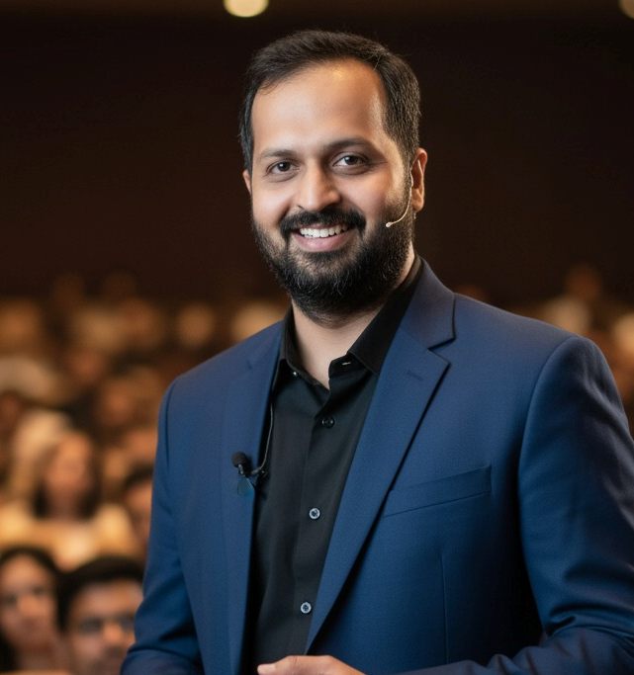

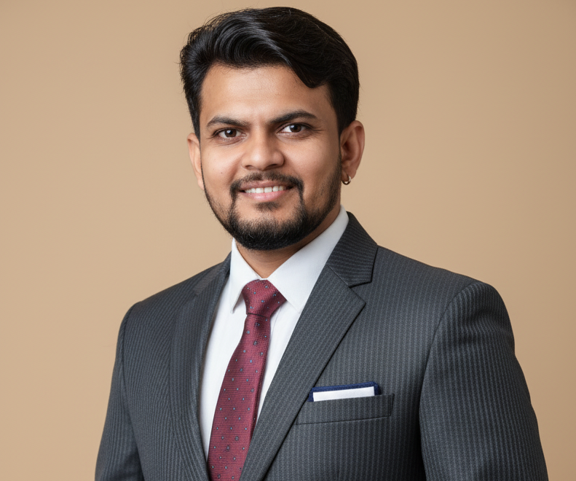
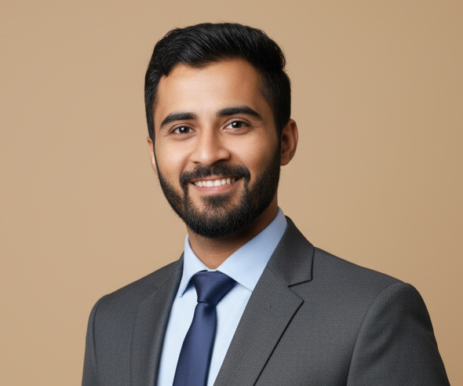
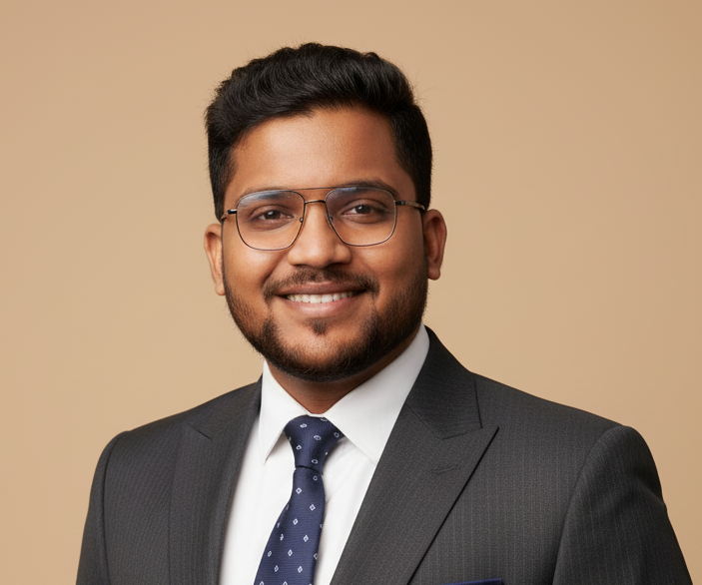
Who Teaches
Dr. Manthan Pandya
Lead Mentor and Market Master
Rudresh Naik
Mahesh Padvi
Satish Meshram
Manoj Lilhare
WAPA Strategy Specialist
WASM Strategy Mentor
Live Market Expert
Foundation Mentor

Slide 15





Choose Your Path to Financial Mastery
MOST POPULAR
CSM
CCM
CPT
MFM
( Certificate in Stock Markets )
( Certificate in Currency Market )
( Certificate in Professional Trading )
( Master in Financial Markets )
Duration : 2 Months
Duration : 12 Months
Duration : 12 Months
Duration : 24 Months
Ideal For : Beginners/students learn essential stock market skills: basics, trading, analysis, and taxation for informed investment.
Ideal For : Beginners/Students master foundational to advanced institutional Forex, risk psychology, and professional trading plans.
Ideal For : Serious Learners master CCM foundation + professional SMC/Price Action for institutional logic and risk management.
Ideal For : Aspiring Full-Time Traders get 24-month professional mastery (Forex/Stocks/Strategies) with 3 certs, mentorship, and assessment.

Slide 16
Course 1: Certificate in Stock Markets (CSM)
Key Details
Course Overview
Duration: 2 Months
Ideal For: Beginners & Students
Fee: ₹5,000 + 18% (GST) = ₹5,900/-
Market Basics
Trading Mechanics
Session Orders
Trend Analysis
Corporate Actions
Financial Metrics
IPO Insights
Sector Analysis
Taxation Compliance
Outcome: Learners gain essential stock market skills to analyse trends, evaluate companies, and make informed investment decisions.

Slide 17
Course 2: Certificate in Currency Market (CCM)
Key Details
Course Overview
Duration: 12 Months
Ideal For: Beginners & Students
Fee: ₹12,500 + 18% (GST) = ₹14,750/-
Forex Fundamentals
Market Mechanics
MT5 Overview
Fundamental Analysis
Technical Analysis
Candlestick Patterns
Trading Strategies
Risk Psychology
Trading Plan
Career Development
Outcome: Learners gain foundational Forex trading skills to analyse markets, execute trades on MT5, and manage risk with confidence.

Slide 18
Course 3: Certificate in Professional Trading (CPT)
Key Details
Course Overview
PART 1 CERTIFICATE IN CURRENCY MARKET
Duration: 12 Months
Ideal For: Serious Learners & Aspiring Traders
Fee: ₹25,000 + 18% (GST) = ₹29,500/-
PART 2 ADVANCED PRICE ACTION
Price Foundations
Market Structure
Key Levels
Trade Execution
Risk Psychology
Outcome: Learners gain skills to trade the Currency Market professionally by mastering institutional Smart Money Concepts (SMC) and Advanced Price Action for high-probability, low-risk execution.
PART 3 SMC MASTERY (SMART MONEY CONCEPTS)
Institutional Logic
Buy/Sell Zones
Market Direction
Trend Continuation
Trend Reversals
Structure Traps
Stop Targeting
Price Inefficiencies
Entry Footprints
Refined Entries
Optimal Locations
Capital Mindset

Slide 19
Course 4: Master in Financial Markets (MFM) – Master Forex, Stocks & Trading Strategies
Course Overview
WINNER MINDSET
ADDITIONAL PREMIUM BENEFITS
Success Mindset
Emotion Control
Greed Management
Action Timing
E-Books & Study Materials
Recorded Sessions
Community Access
Cheat Sheets
Q&A Sessions
Market Alerts
Mini-Webinars
Trading Journal
Weekly Insights
Indicator Guides
Risk Worksheets
P&L Trackers
Lifetime Updates
Priority Support
Mobile Learning Access
Strategy Back tests
Case Studies
Certificate in Stock Markets
Certificate in Currency Market
Certificate in Professional Trading
ASSESSMENT & EVALUATION
PREMIUM DIGITAL ASSETS
Personality Test
Psychology Test
Market Experience
behaviour Test
Target Return
Trading View Templates
Risk Calculators
Market Checklist
Analysis Reports
EXCLUSIVE MEMBERSHIP
MENTOR CONSULTATION
Offline Workshops
Wealth Sessions
1-on-1 Mentorship
Signal Access
Account Credit Bonus
Trading Method
Risk Assessment
Goal Planning
Duration: 24 Months
Ideal For: Aspiring Full-Time Traders & Professionals
Fee: ₹45,000 + 18% (GST) = ₹53,100/-
Outcome: Learners gain skills to become a confident, disciplined, and professional trader in Forex, Stocks, and Financial Markets
Key Details

Slide 20


WealthGenics Course Comparison Matrix
Features (suvidhaen)
CSM (Stocks)
CCM (Currency)
CPT (Pro Trading)
MFM (Master)
Duration
2 Months
12 Months
12 Months
24 Months
Course Fee (with GST)
₹5,900
₹14,750
₹29,500
₹53,100
Stock Market Basics & Taxation
Forex & Currency Basics (MT5)
Smart Money Concepts (SMC)
Advanced Price Action
Institutional Logic & Traps
Psychology & Behavior Test
1-on-1 Mentorship
Offline Workshops Access
Lifetime Updates & Community

Slide 21


India’s ONLY Academy with Scientific Trader Profiling
With Teamlead Career Training & Global Services LLP, WealthGenics becomes India’s ONLY Online academy providing scientific, personality-based trader profiling — matching your psychology, personality, risk behaviour, and experience to the trading style built FOR YOU.
No other institute in India offers this edge.
Psychology & behaviour Assessment
Scientific Trader Personality Assessment
Trading is 80% psychology.
Teamlead builds the mind of a true winner.
Identify your ideal trading style using tests designed with Teamlead.
ASSESSMENT FOR:
WHAT WE ANALYSE:
Winner Mindset Training
Emotional Control in Tough Market Phases
Fear & Greed Management
Discipline & Decision-Making Frameworks
Survival Strategy during Losing Streaks
Scalper & Intraday Trader
Swing Trader
Positional Trader
Price-Action & Indicator-Based Trader
Psychology + Personality + Behaviour + Risk Profile
Benefit: You become emotionally strong, consistent, and stable — the kind of trader who wins long-term
Benefit: Trade smarter, not harder. Follow the trading style that fits you for faster, safer growth.

Slide 22








WHY WEALTHGENICS!!
1. A Personalised Trading Blueprint Designed for YOU
6. Earn in Rupees ₹ AND Dollars $
You get a trading style tailored to your psychology, personality & risk appetite — ensuring faster, safer and more consistent growth.
Global market skills give you the power to build multiple income streams in INR and USD.
2. Trading Becomes a Lifelong Income Skill
7. Courses Built by Industry Experts + Teamlead Strategy Professionals
A skill you carry for life — earning from anywhere, anytime, even when your job or business doesn’t support you.
Your entire program is designed with market expertise + psychological science + business strategy for maximum success.
3. India’s Smartest Financial Community
8. Mentorship + Accountability = Consistency
Grow with mentors, traders and ambitious learners who accelerate your progress every single day.
Trading success comes from discipline — and you get guidance, support, doubt solving, and a community to keep you consistent
4. Structured Training from Basic to Advanced
9 A Clear Path to Financial Independence
Step-by-step, practical, real-world training — not random YouTube tips or outdated theory.
You learn how to grow money, manage money, multiply money and build long-term wealth — not just earn salary.
5. Dual-Market Power: Stock Market + Global Forex
10. Multiple Career Paths after Training
You gain expertise in both:
✔ Indian Stock Market
✔ Global Forex Market
This doubles your opportunities and multiplies income potential.
You can build a career as a
✔ Professional Trader
✔ Market Analyst
✔ Portfolio Consultant
✔ Financial Educator
And many more………………

Slide 23
Exploring Multiple Career Paths After Training
Certified Portfolio Manager (PMS)
Investment Advisor (SEBI Certified
Prop Firm Trader
Risk Manager
Mentor
Certified Analyst
Algo Trader
Market Blogger
Brokerage Firms
Your learning doesn’t stop. It evolves into a career

Slide 24









OF MERIT
THIS CERTIFICATE IS PROUDLY PRESENTED TO
Mr. Raviraj Singh
Awarded the "Certification in Currency Market (CCM)" upon successful completion of the program, conducted by WealthGenics Educart Private Limited & Teamlead CTGS.
Date of Issue: 05^{h} Nov, 2025
Certificate No: WG|TL|CCM|W001
CEO WealthGenics
CEO TeamLead

Slide 25
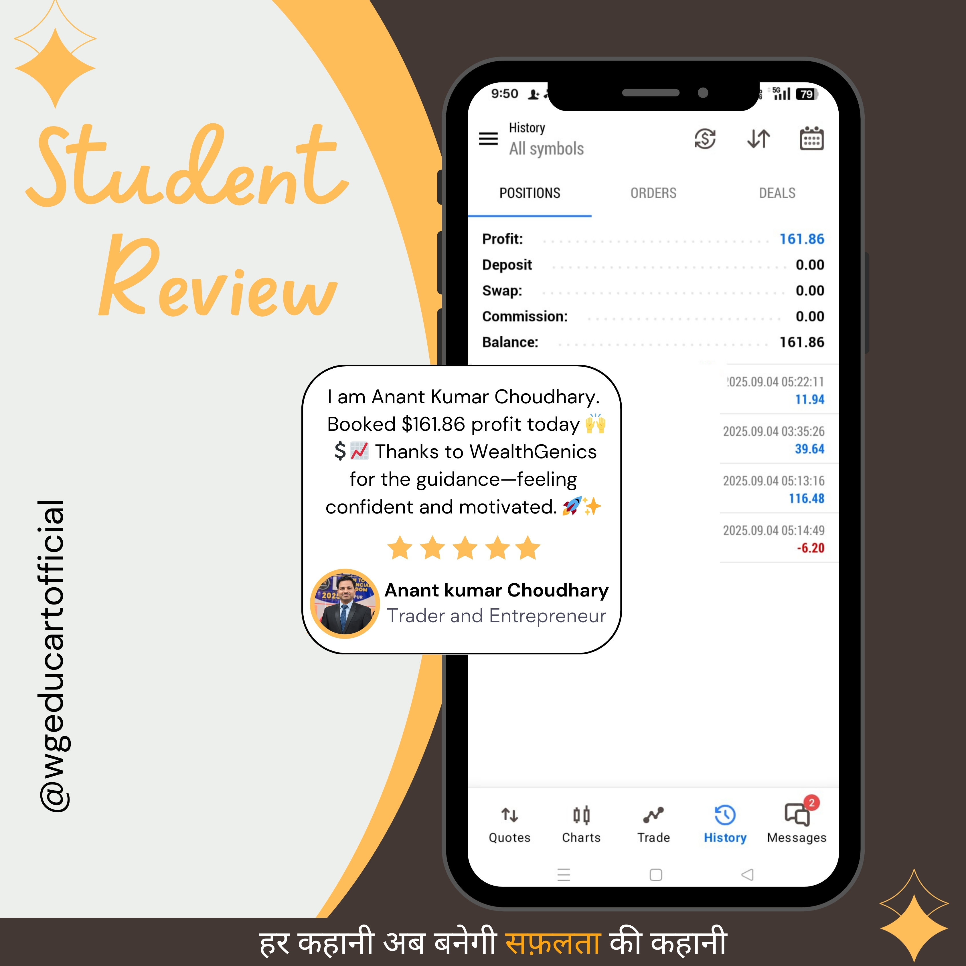
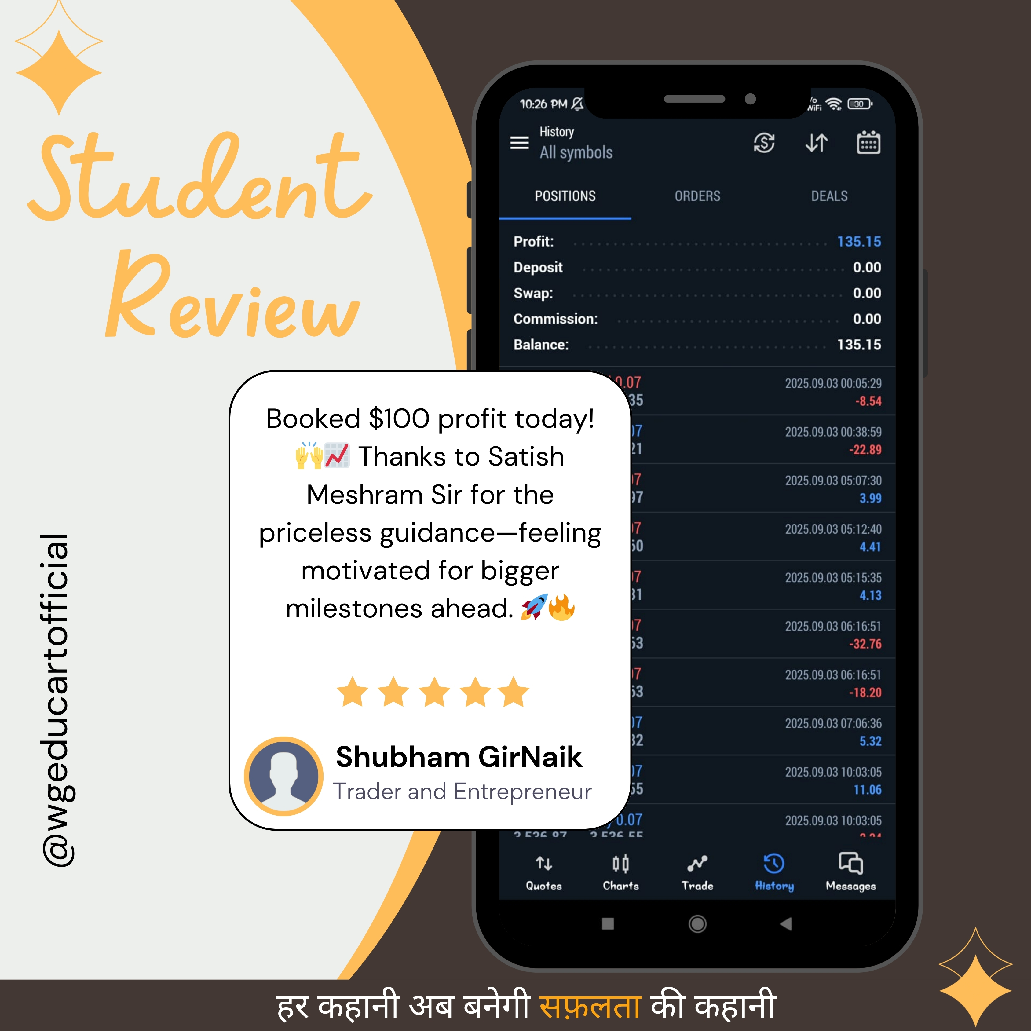
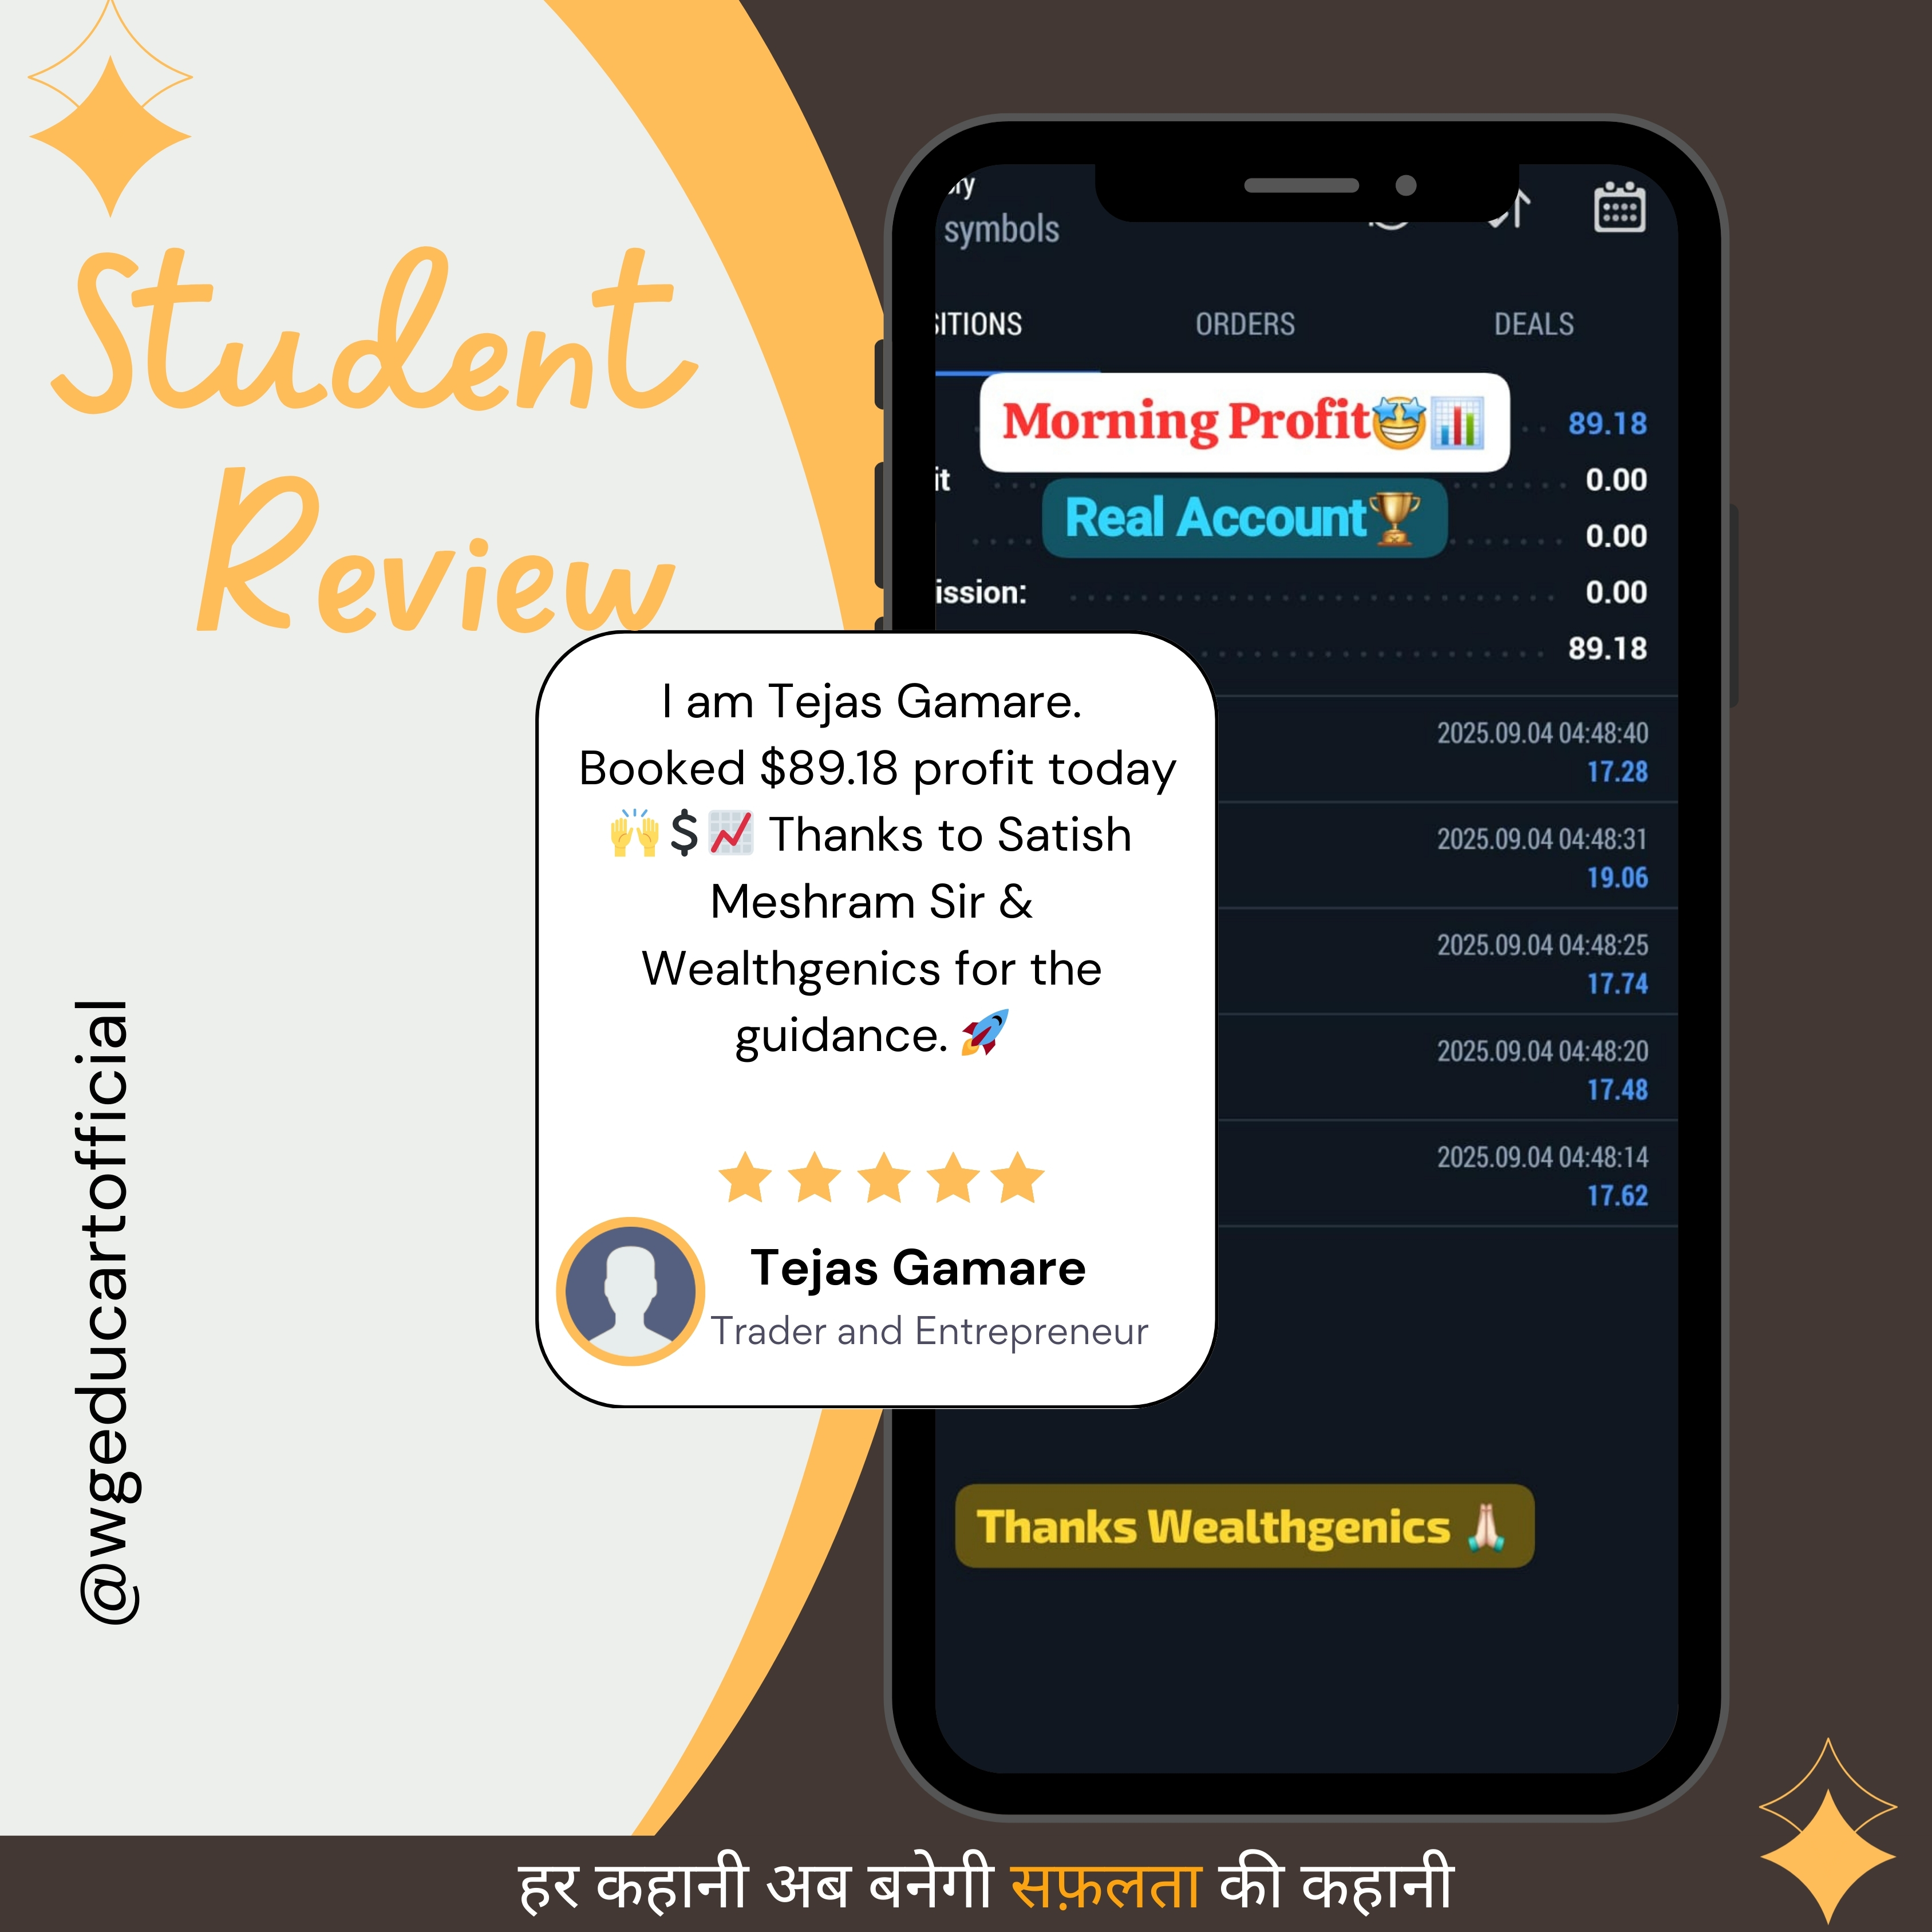
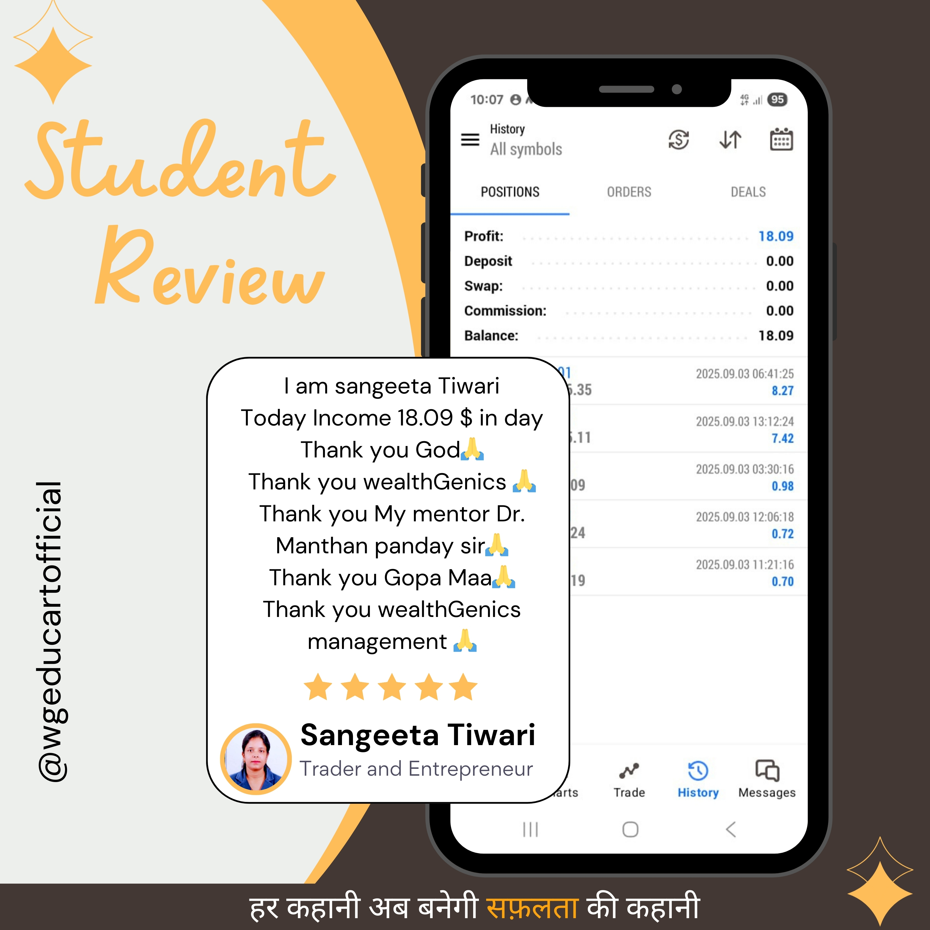
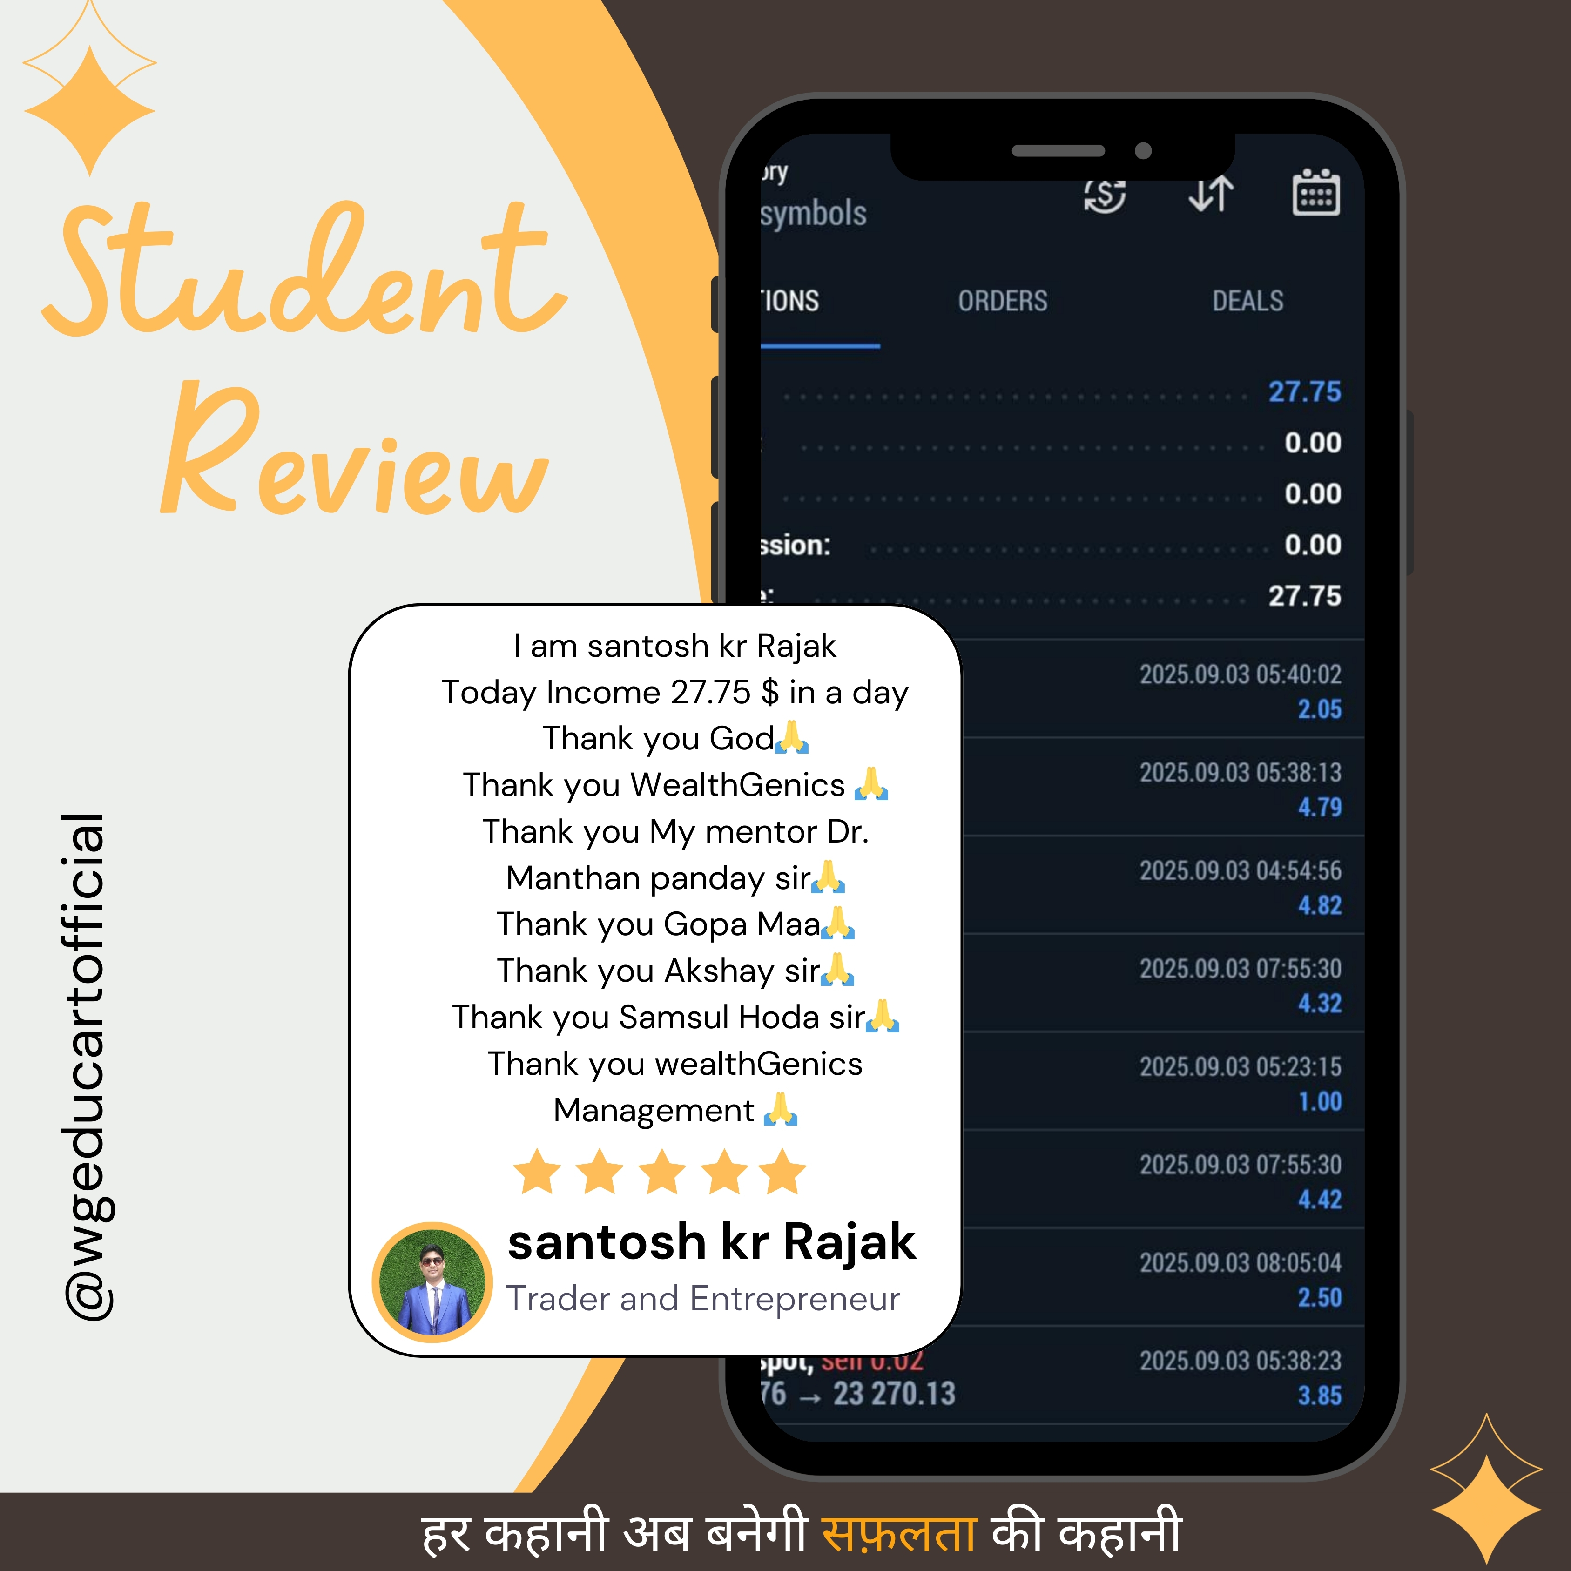
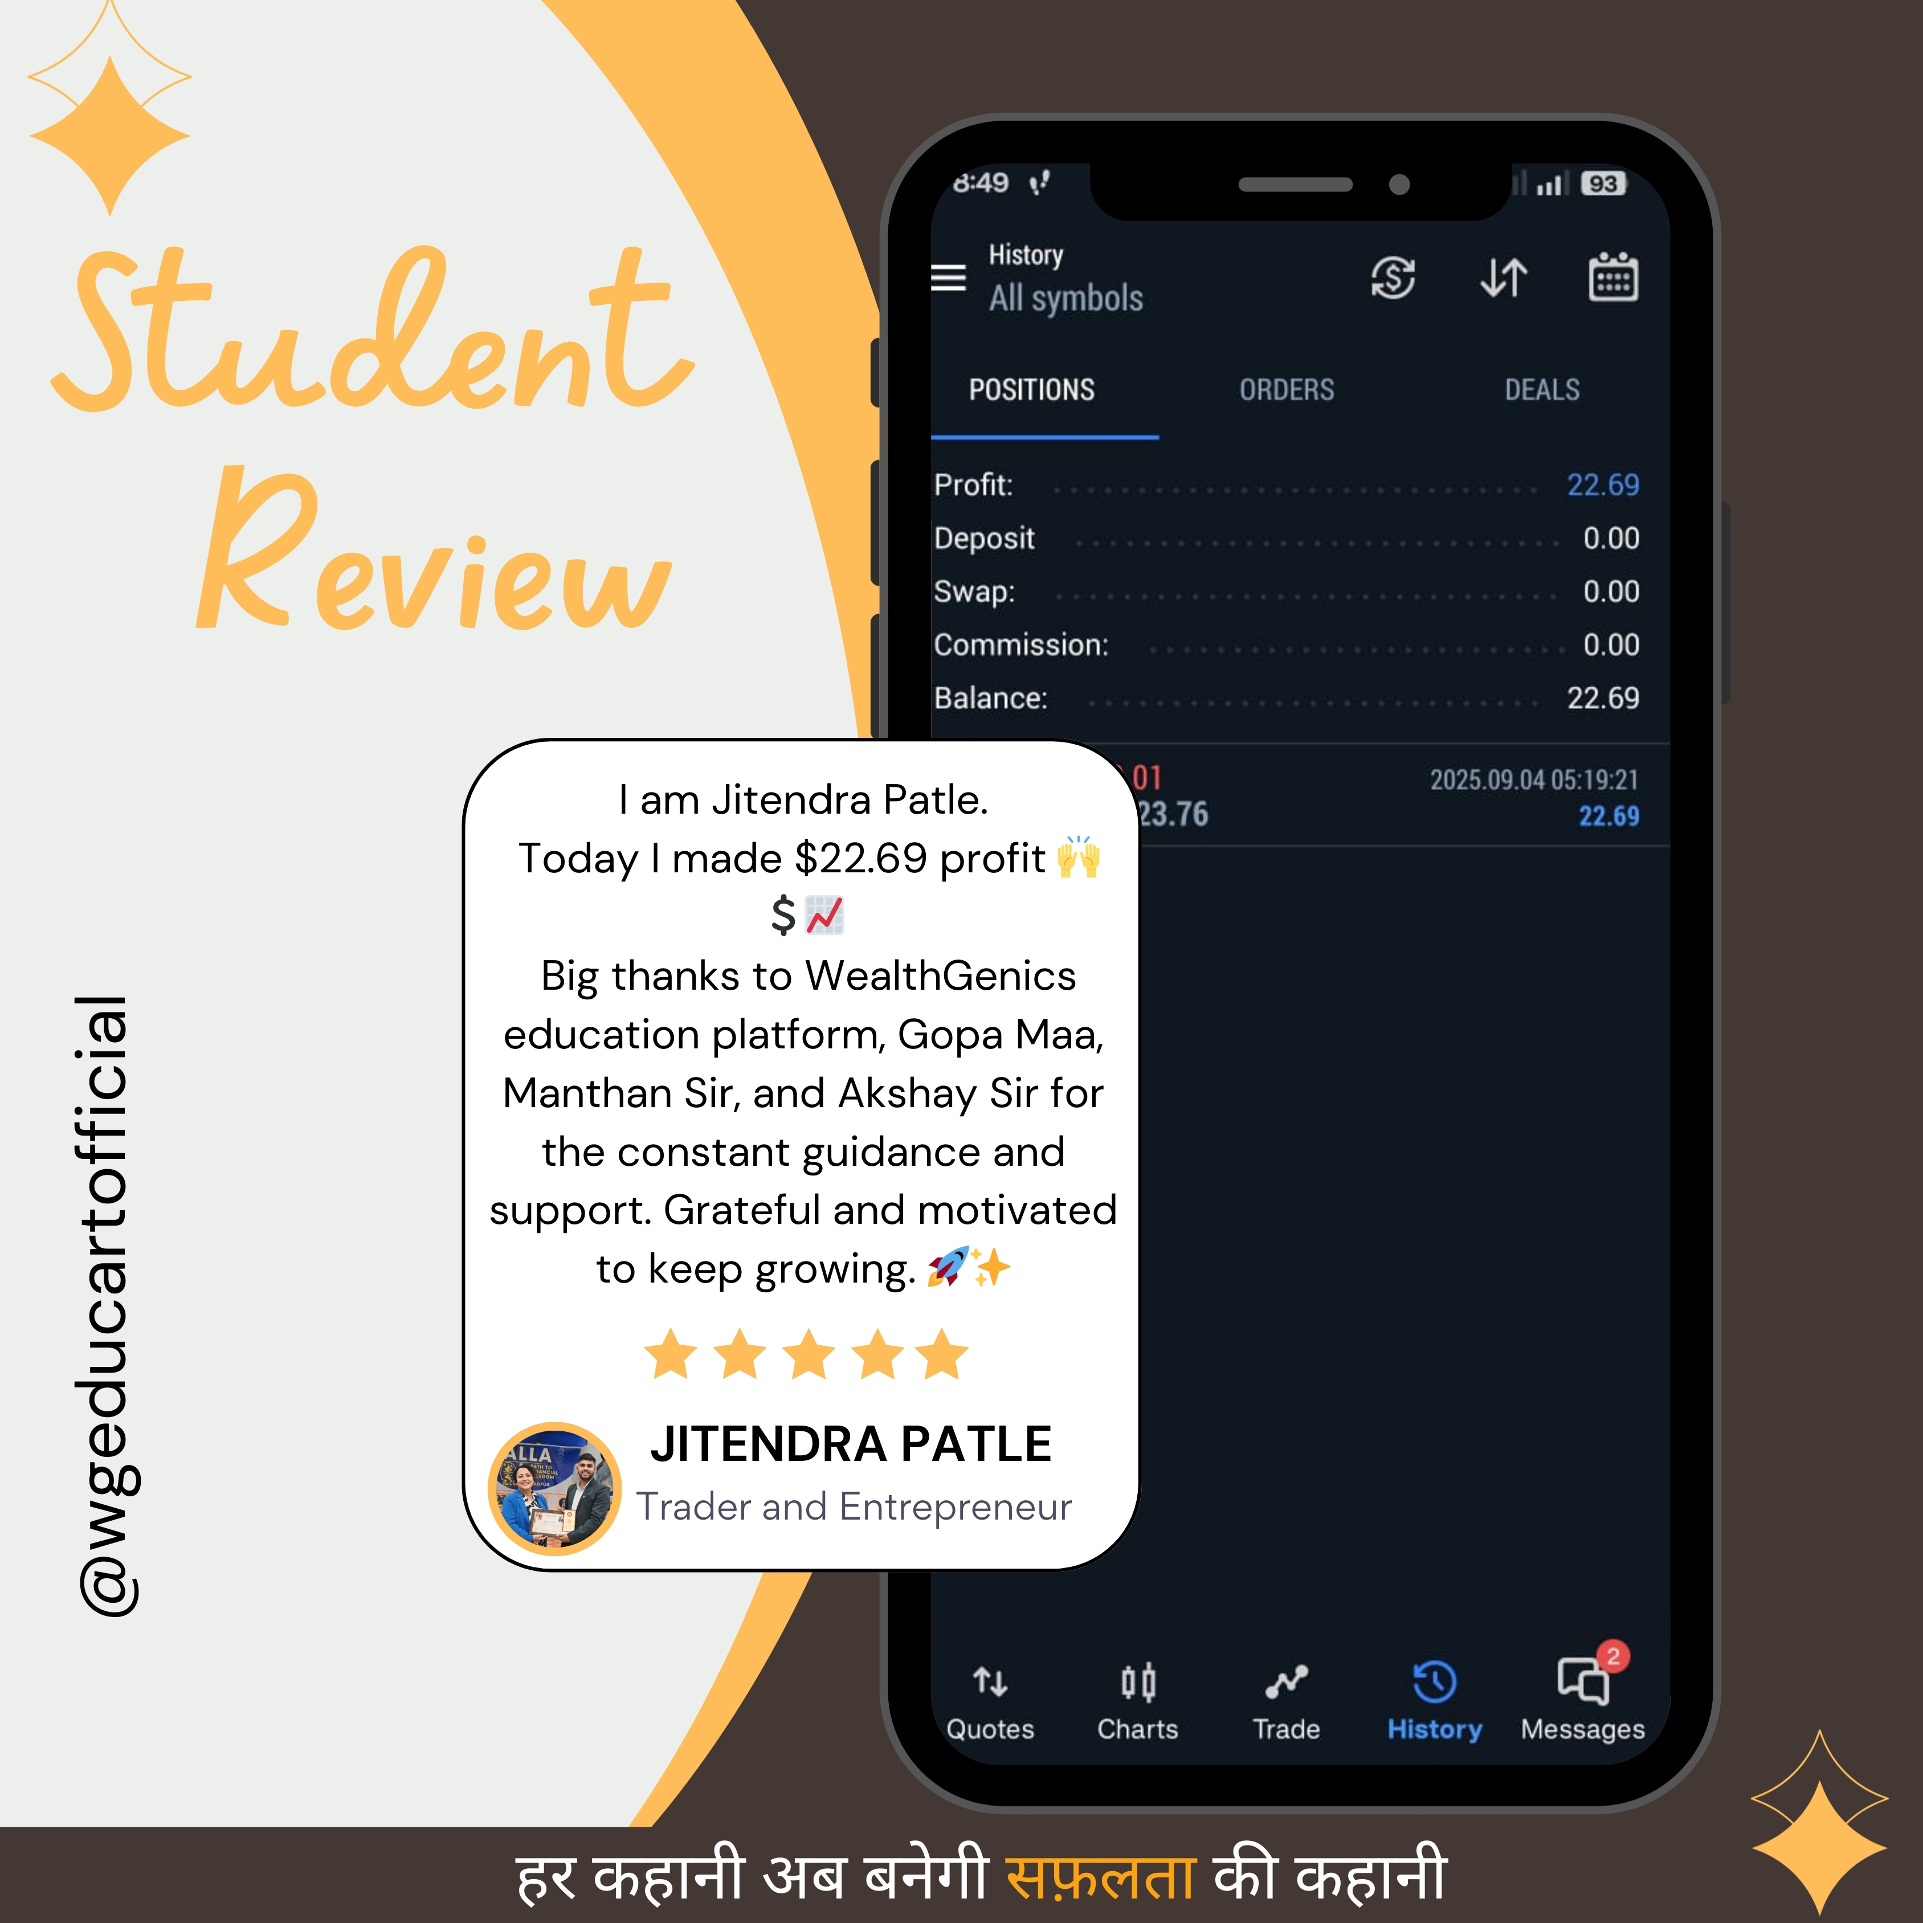
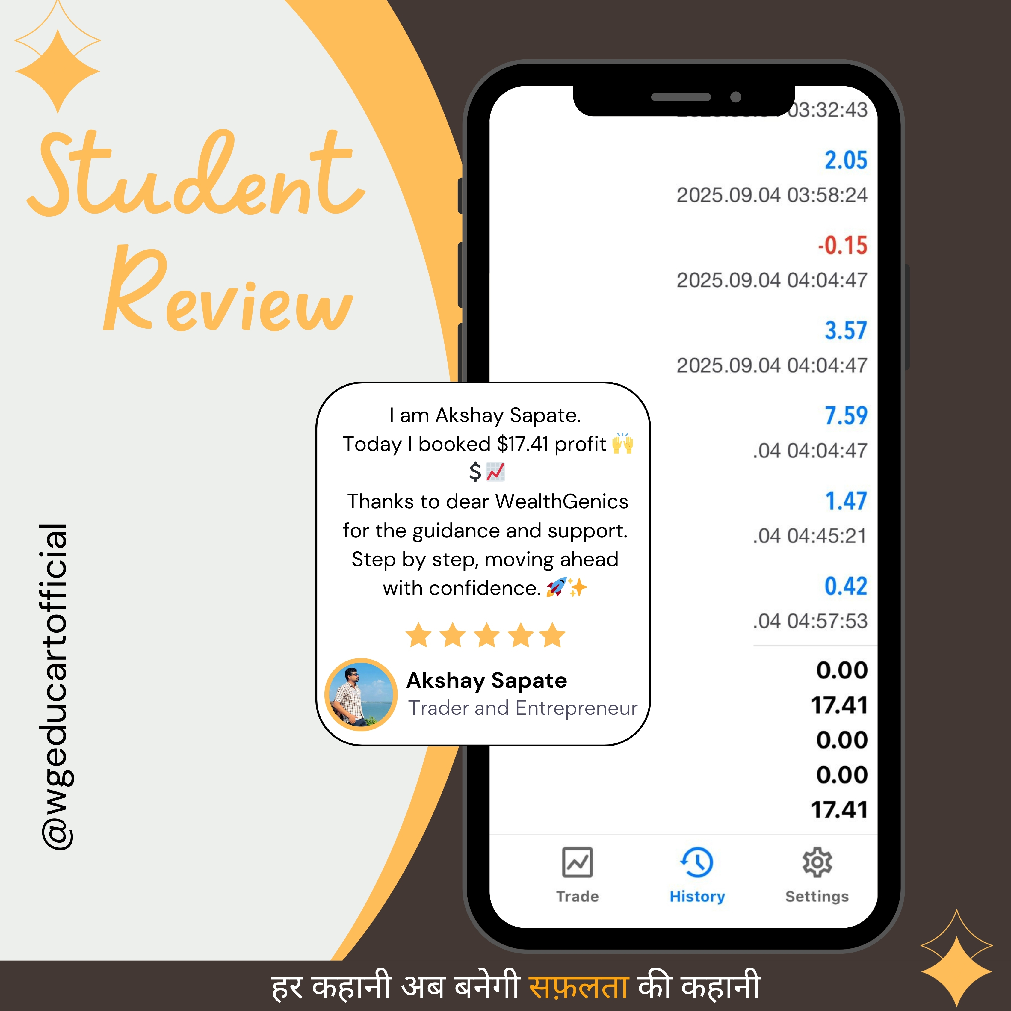
"SUCCESS STORIES ON PROFITS & WINS"

Slide 26
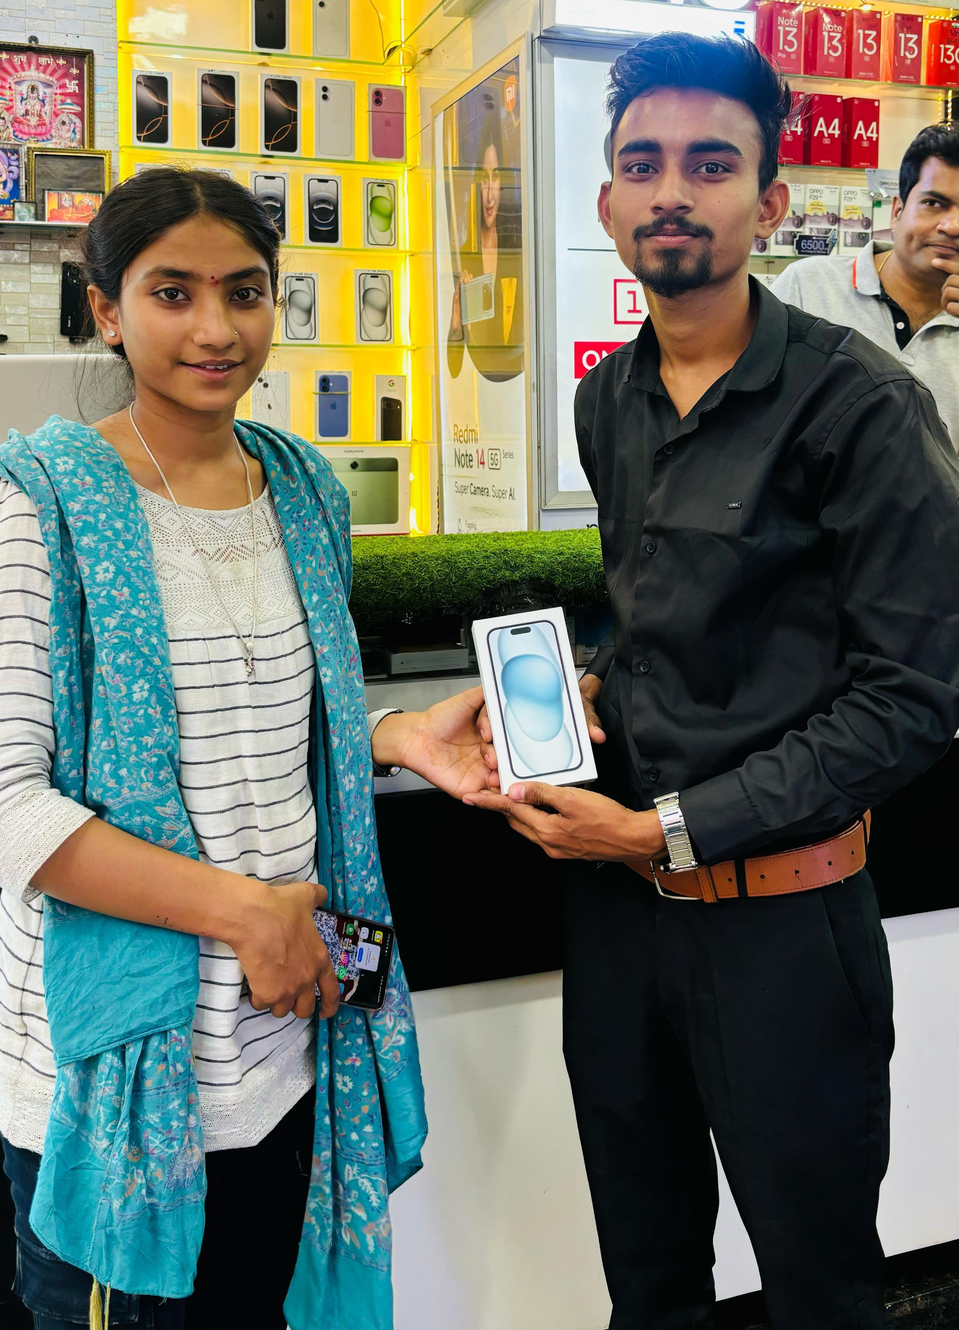
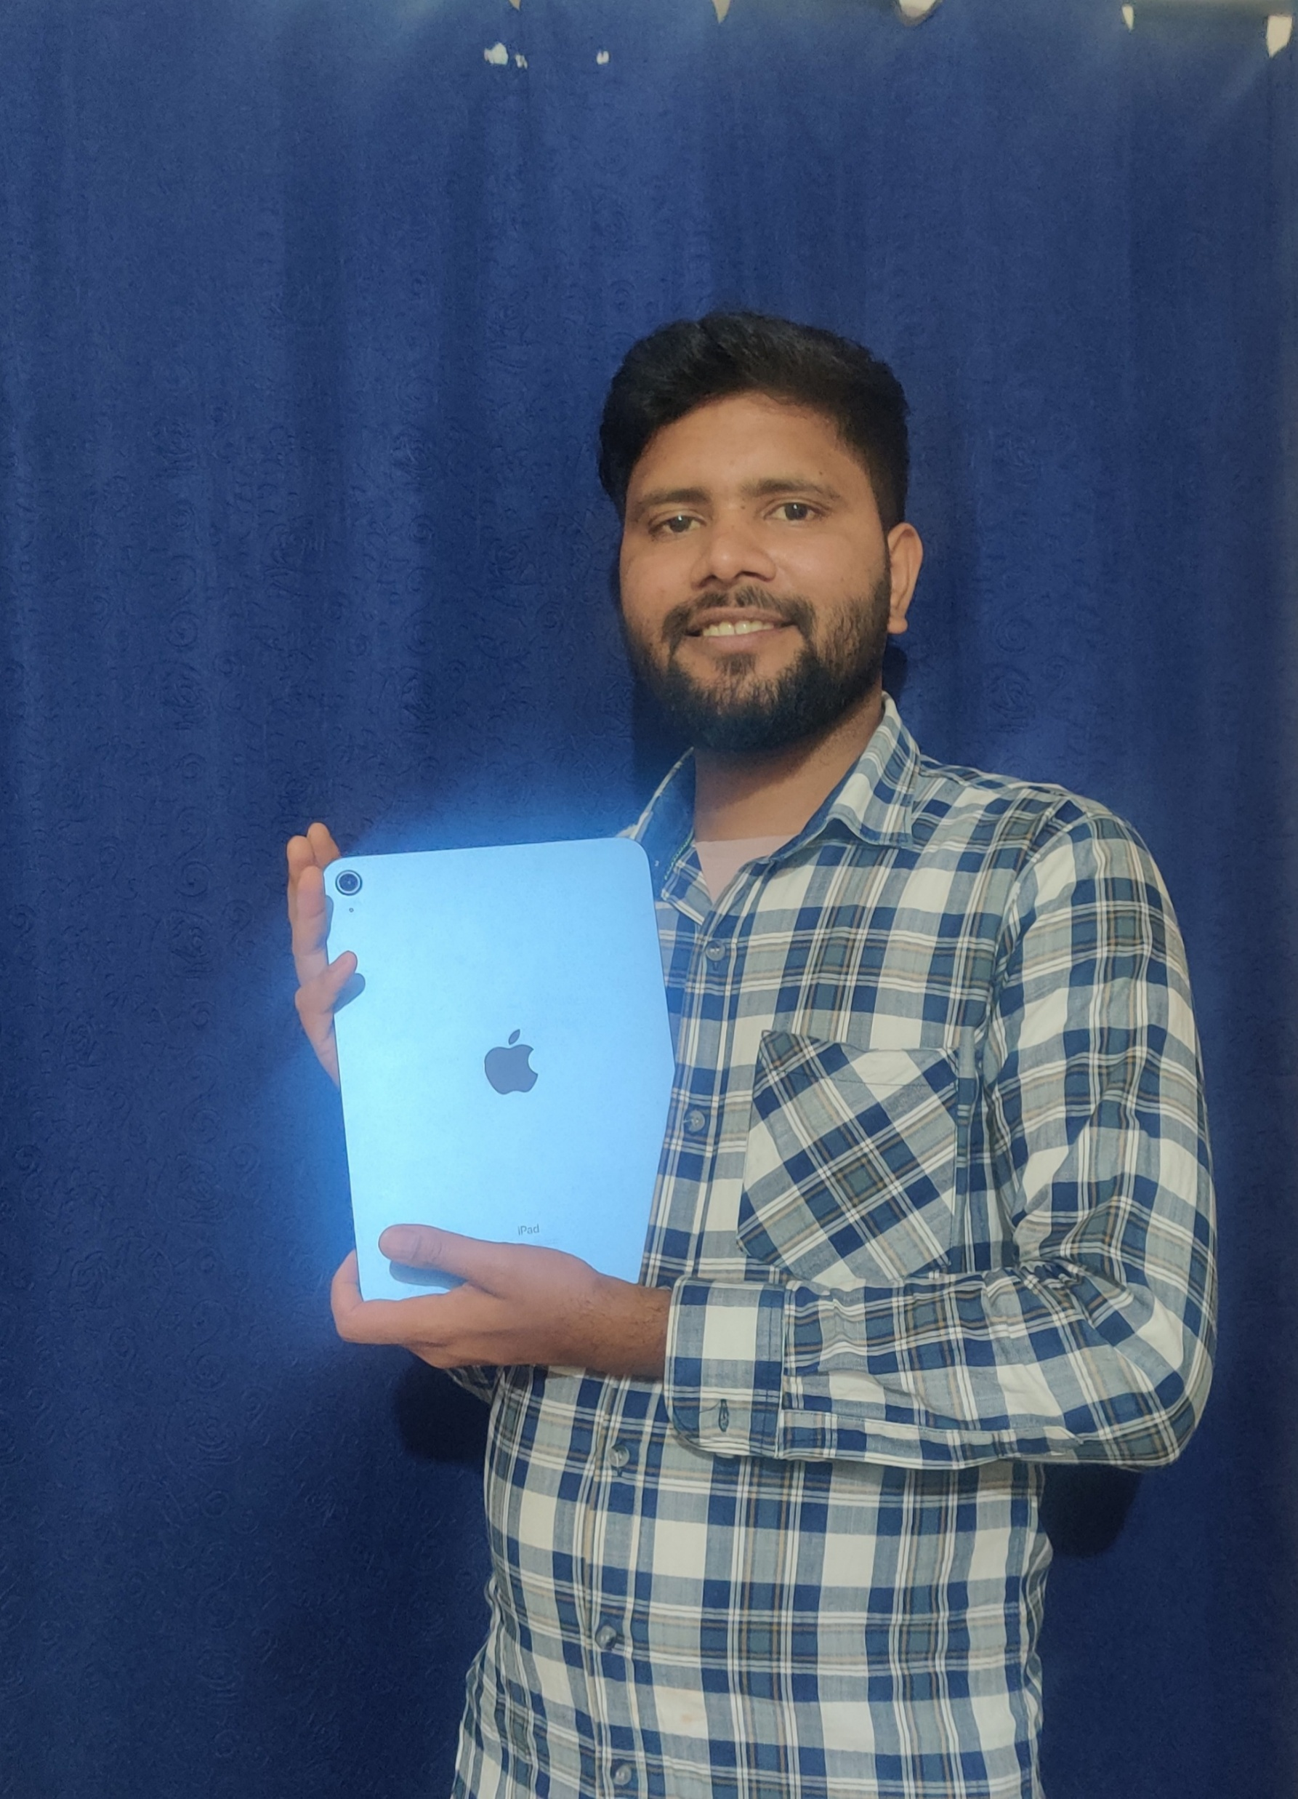


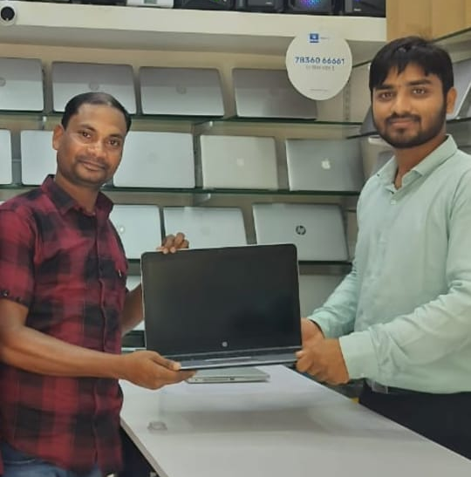
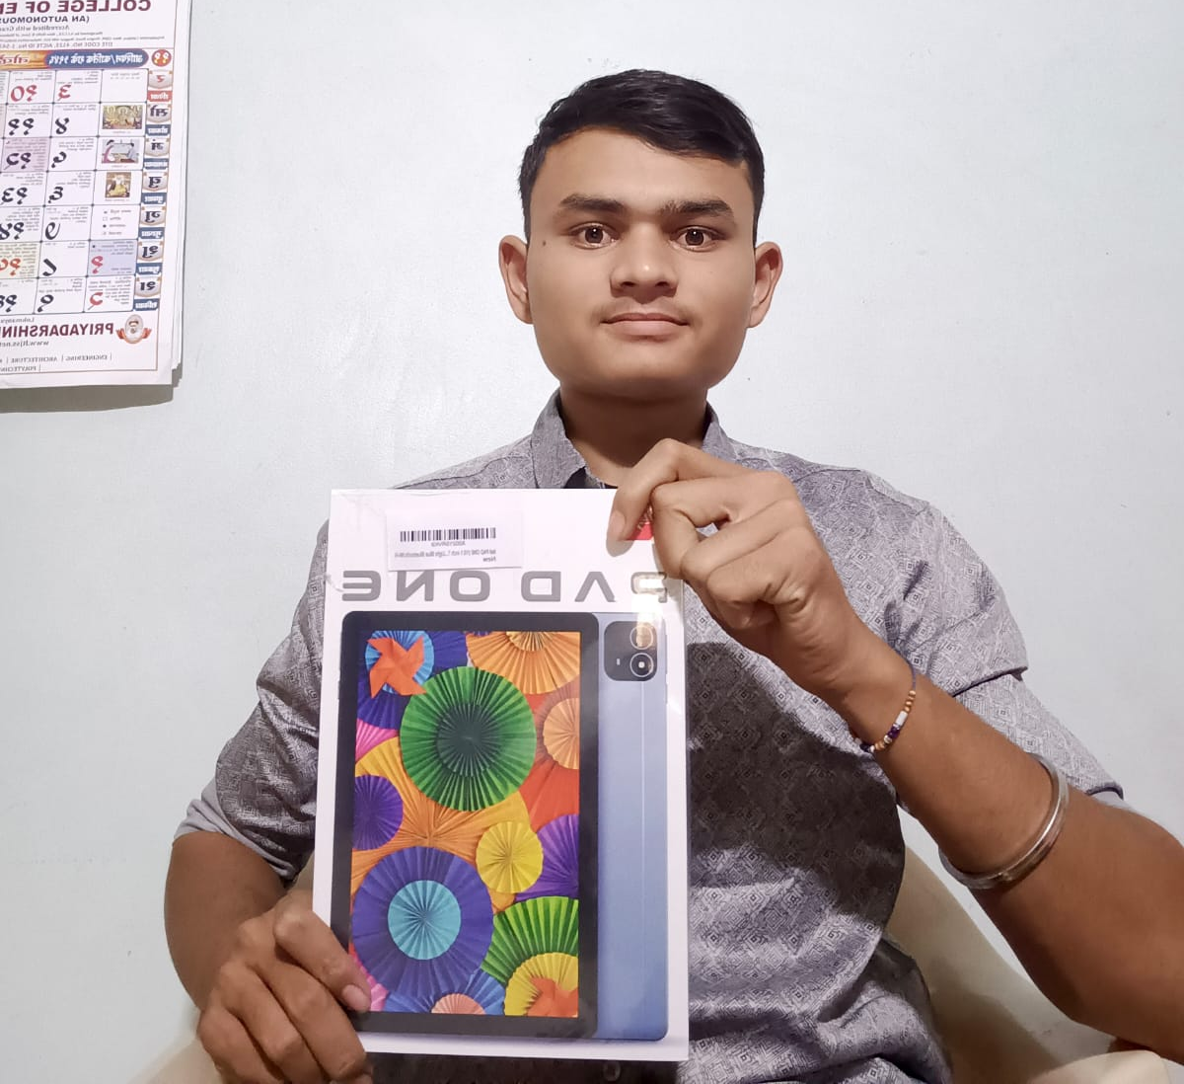
"SUCCESS STORIES ON WHEELS & WINS"
SWAPNIL GHATE
PARSURAM PANCHESHWAR
PRANJALI KHADSE
RUPALI KARRI
HEERA SINGH UIKEY
TEJAS KHARE

Slide 27








"SUCCESS STORIES ON WHEELS & WINS"
SK EBAD ALI
RAKESH GOUTAM
PRANJALI KHADSE
RUPALI KARRI
PARISHED VAIDYA
POOJA PAWAR & VAIJANATH PAWAR
AVINASH NAGPURE
JITENDRA PATLE

Slide 28
The WealthGenics Advantage
Where Learners Become Leaders
🎓 Scholarships (₹7,500 – ₹25,000) → Direct support for learners.
👨‍👩‍👧 Nominee Transfer → Your family continues the business legacy.
🏠 All-in-One Ecosystem → Education, mentorship & growth under one roof.
📚 100% Educational Model → No funds handled, only knowledge-driven.
🧑‍🏫 Real Mentorship → Live workshops & personal guidance, not just modules.
💰 Daily Payouts → Transparent, consistent, and instant earnings.
🌍 Global Strategies → Learn institutional & smart money concepts.
🔒 Ethics & Transparency → Compliant, trustworthy, and future-ready.
💡 Wealth Mindset & Life Skills → Beyond trading, a path to financial independence.
🚀 Learner-to-Leader Path → Grow from student → expert → mentor.
🧑‍🏫 Career Placement Support → Guidance & opportunities based on your expertise.

Slide 29

Vision 2030
1 Million Financially Independent Families
🎯 “1 Million Financially Literate Families by 2030”
🏆 “India’s No.1 Financial Education Ecosystem”
🌍 “Global Presence – Taking WealthGenics Beyond Borders”
❤️ “हर कहानी अब बनेगी सफलता की कहानी”

Slide 30




Lifestyle Vision – The WealthGenics Way
INTERNATIONAL TRIP
NEW CARS
NEW HOME
SCHOLARSHIP AWARDS
From First Bonus to Foreign Trips — Every Step is a Celebration.

Slide 31

WealthGenics Promise
Not just income…
It’s Recognition,
Lifestyle,
&
Legacy

Slide 32
Why Now ?
📈 Financial markets are booming like never before.
📲 Digital India is creating massive opportunities.
⏳ The best time to start was yesterday. The next best is NOW.
The earlier you start, the bigger you grow

Slide 33

You Are The Next

Slide 34
Disclaimer
At WEALTHGENICS EDUCART PRIVATE LIMITED,
we provide financial education and real time technical analysis to our subscribers, emphasizing knowledge acquisition. We do not participate in fund management or investment activities. All trading decisions are made at the subscriber's own risk. We firmly disapprove of illegal activities and are not liable for any investment choices made by our subscribers.

Slide 35
We empower every learner to rise as a confident entrepreneur and a true wealth creator
हर कहानी अब बनेगी सफलता की कहानी

